Slide 1
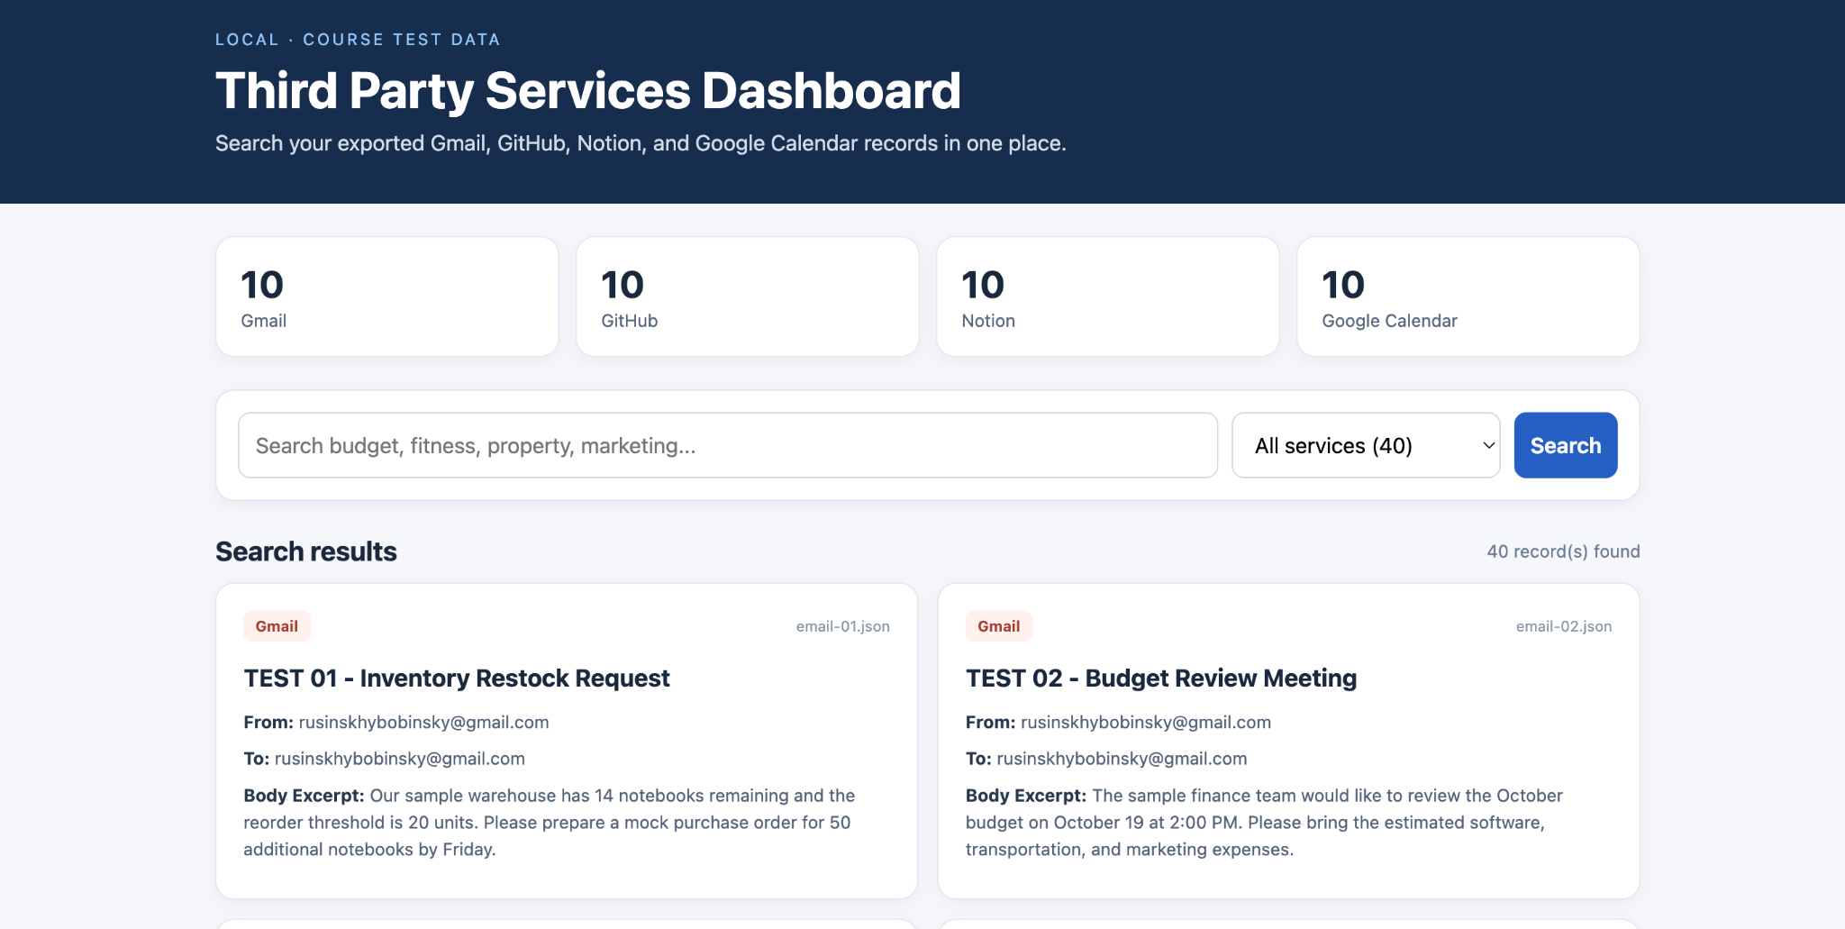
Third Party Services Dashboard
A local searchable website combining four separate cloud services
PROJECT OVERVIEW
40 test records
10 Gmail messages • 10 GitHub repos
10 Notion pages • 10 Calendar events
Screenshot: working local dashboard
THIRD PARTY SERVICES DASHBOARD • OCTOBER 2026
1

Slide 2
Project Goal and Process
From connected services to locally stored, searchable records
Create test content
Retrieve and store
1
2
Separate coursework accounts and clearly fictional records
Organize records as JSON under dataExports
Search in browser
Check results
3
4
Run Python locally and search across services
Validate file structure and compare against sources
THIRD PARTY SERVICES DASHBOARD • OCTOBER 2026
2

Slide 3
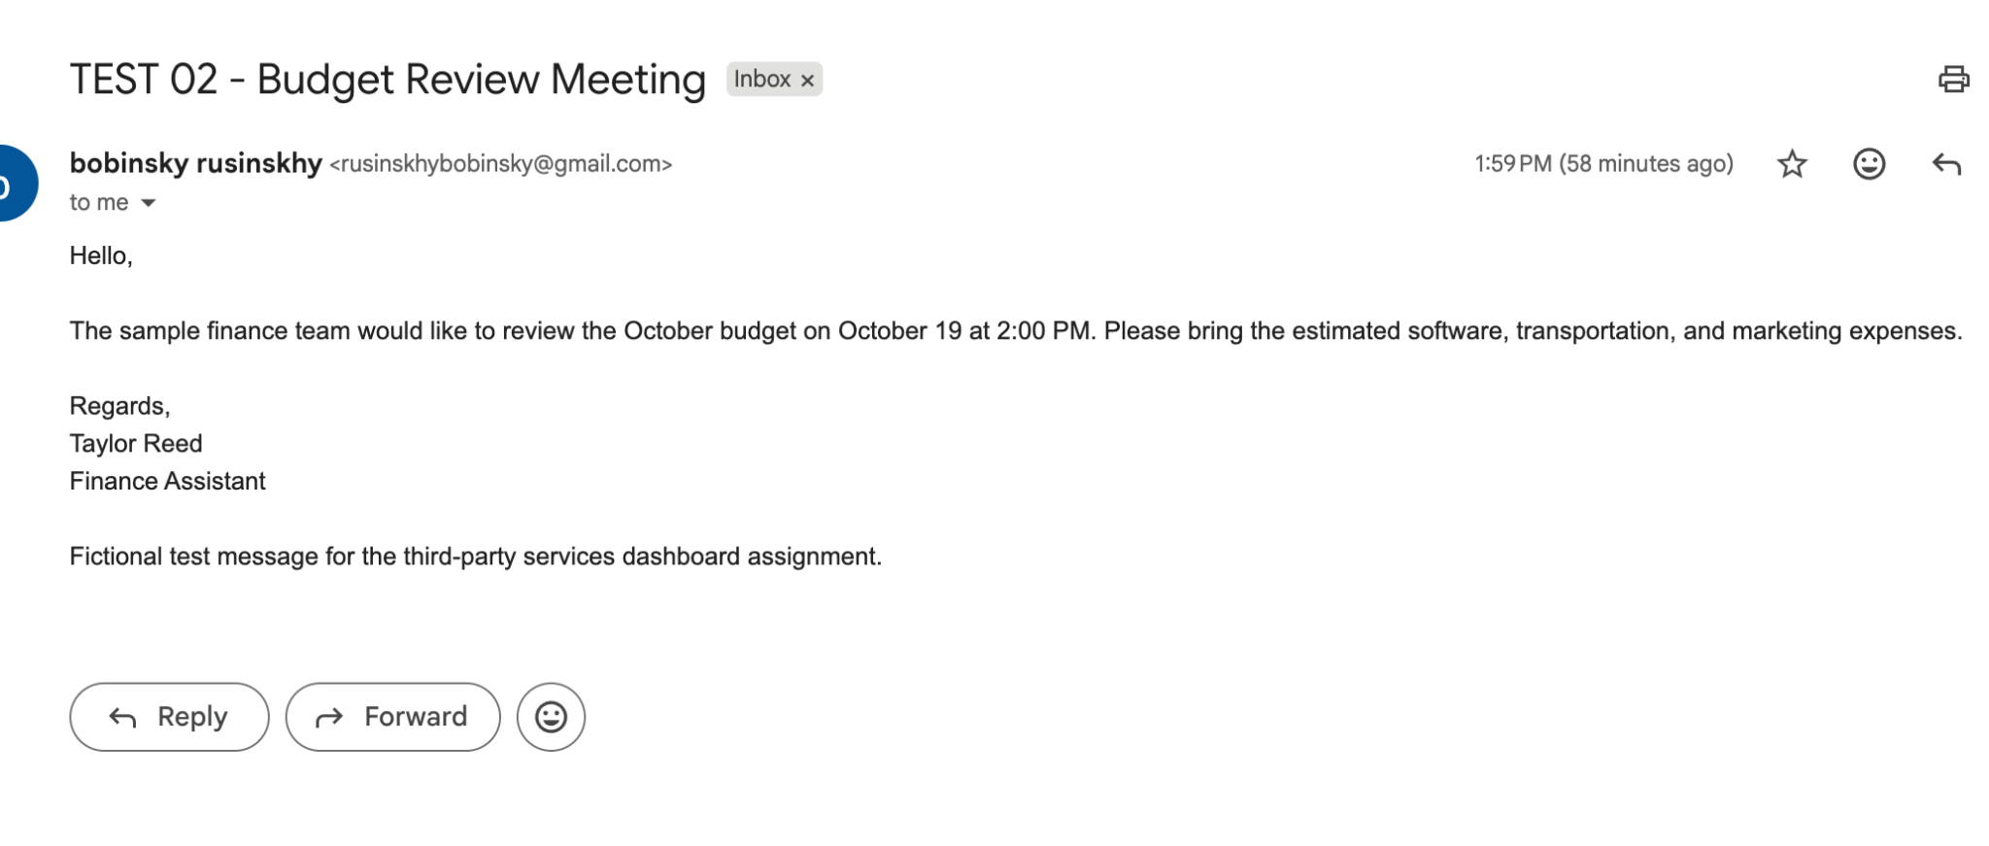
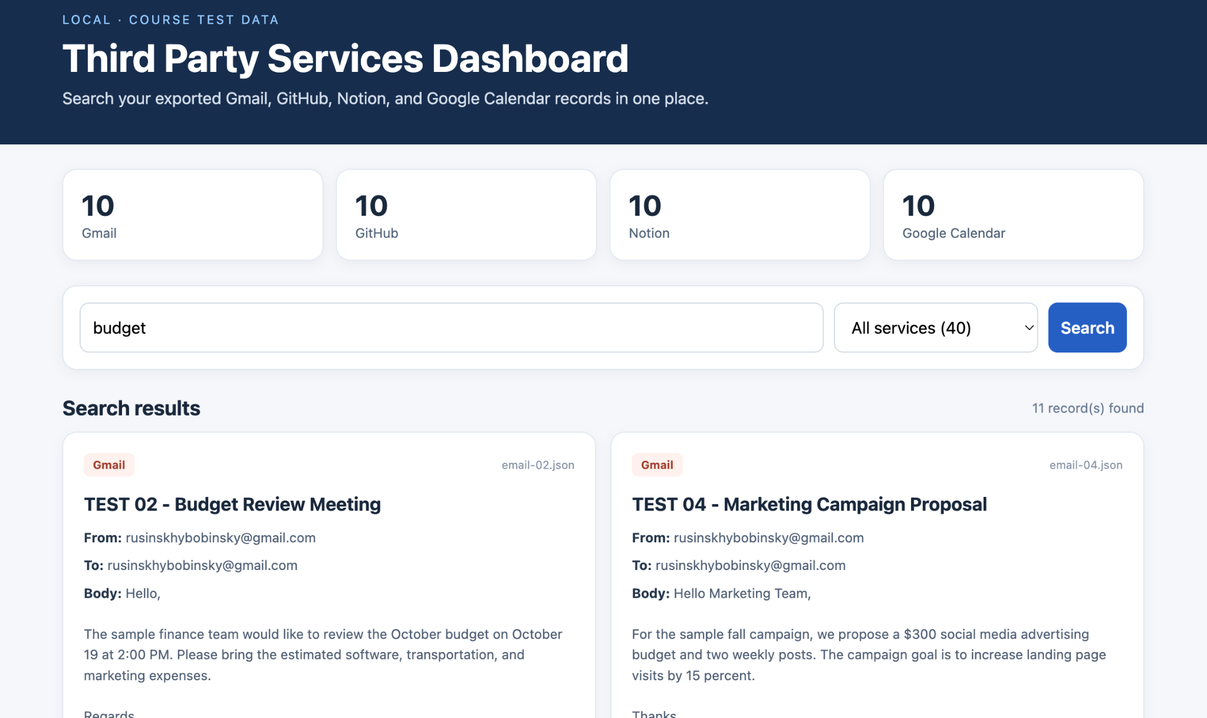
Gmail — Source vs. Dashboard
TEST 02 — Budget Review Meeting
ORIGINAL SERVICE
LOCAL DASHBOARD
Original test email compared with its indexed dashboard record.
THIRD PARTY SERVICES DASHBOARD • OCTOBER 2026
3

Slide 4
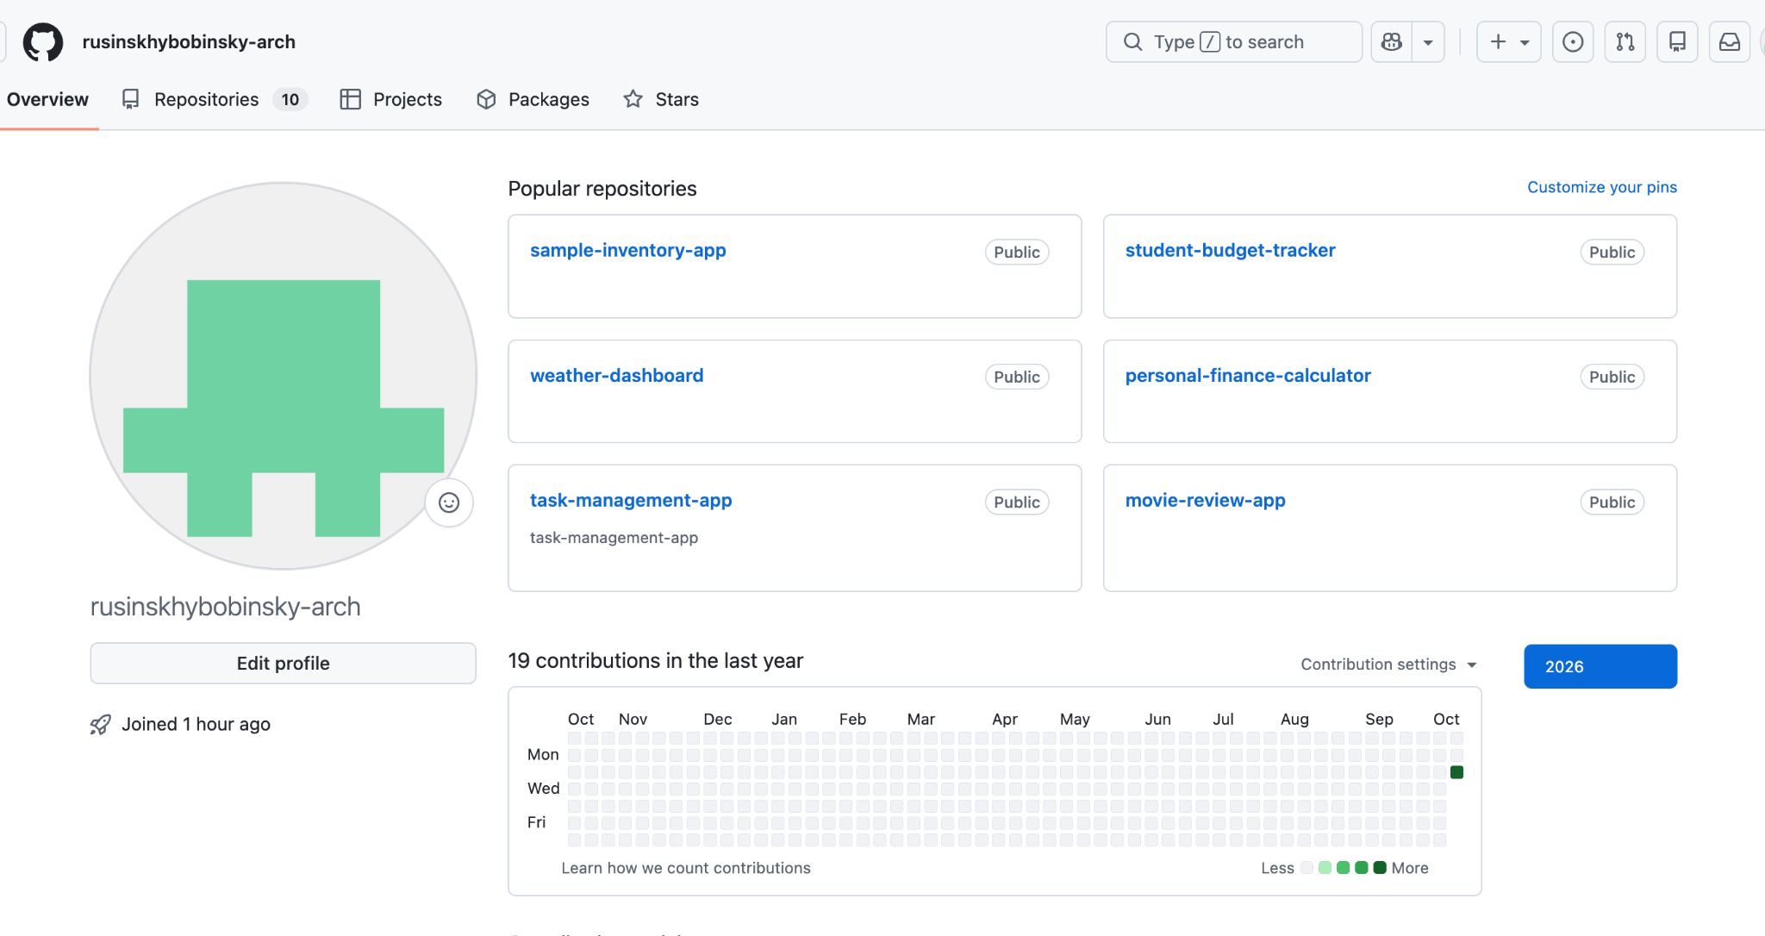
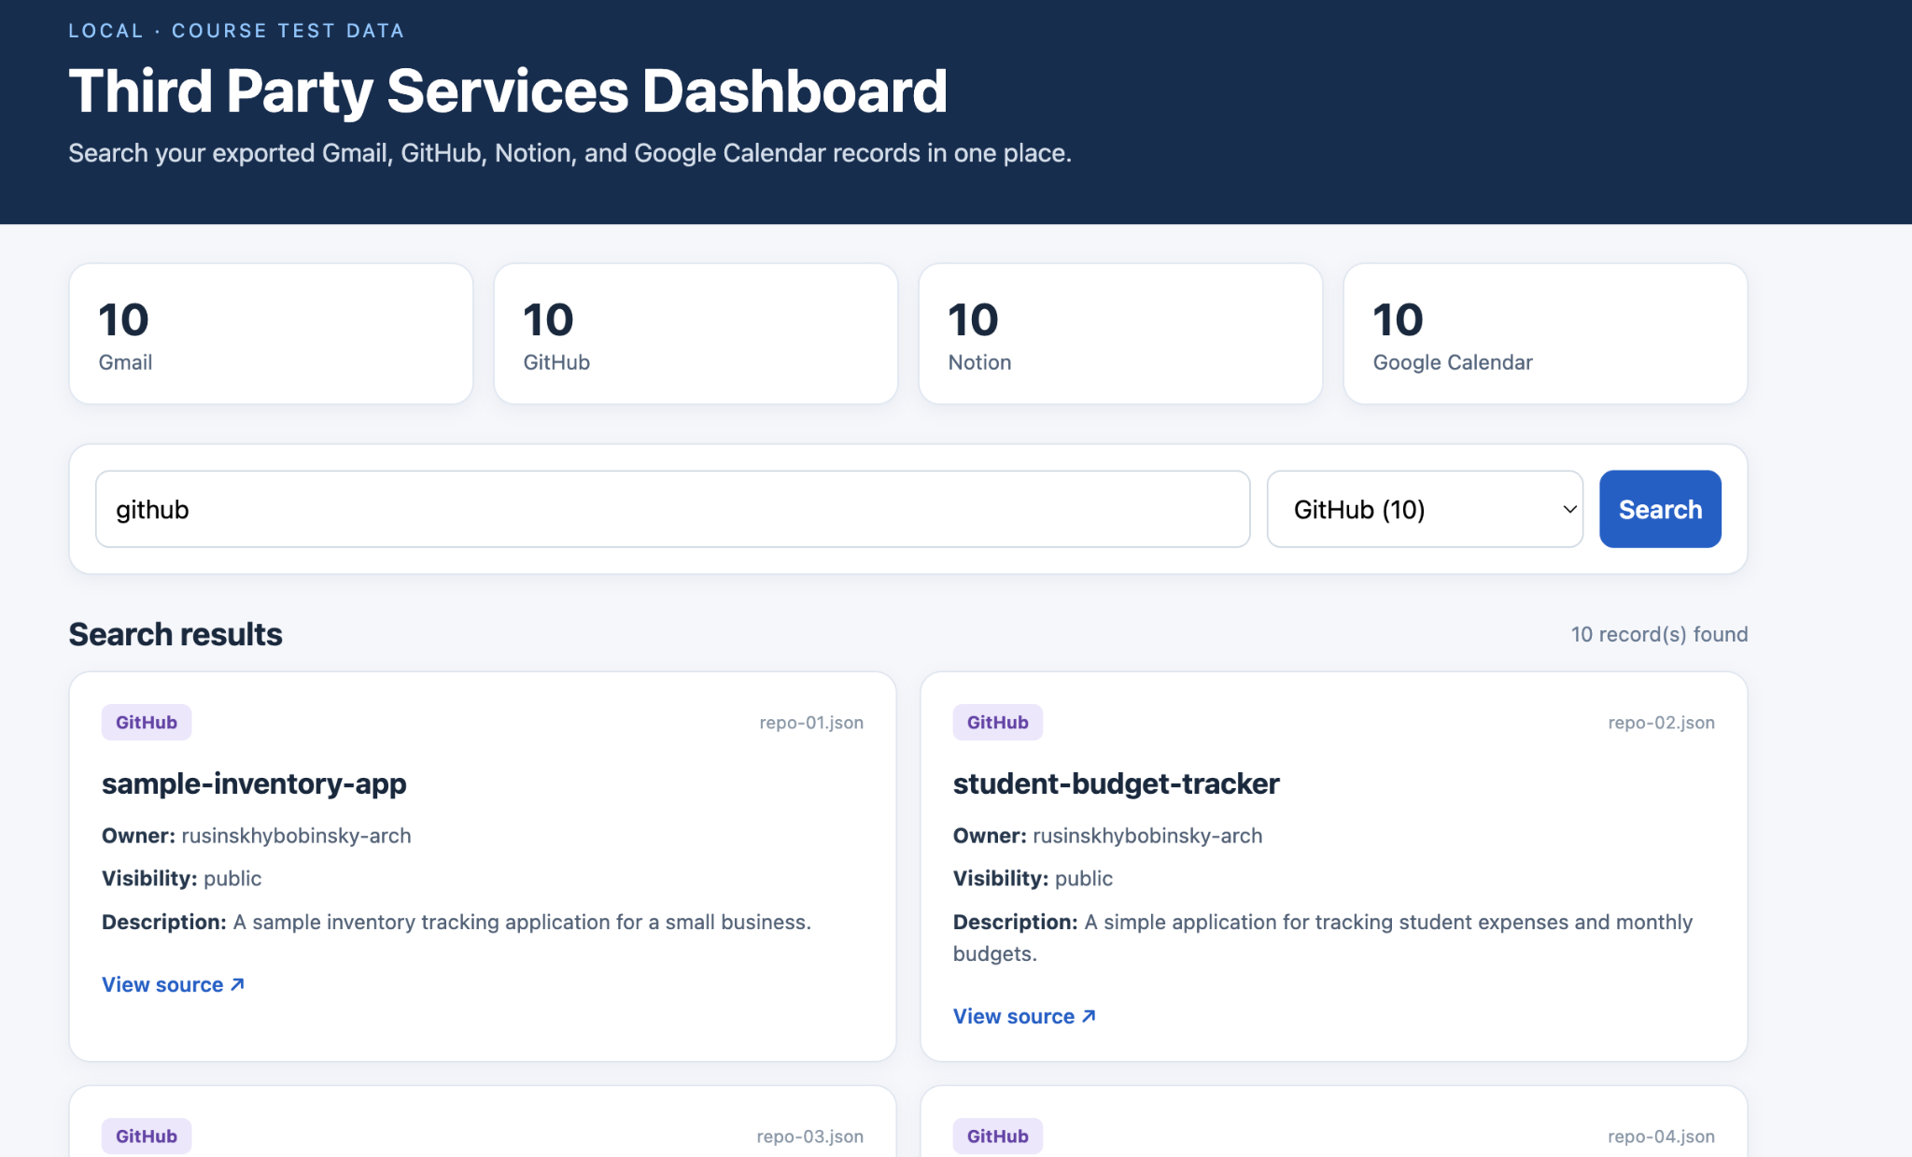
GitHub — Source vs. Dashboard
Public test repositories
ORIGINAL SERVICE
LOCAL DASHBOARD
GitHub profile confirms 10 repositories; dashboard filters 10 GitHub records.
THIRD PARTY SERVICES DASHBOARD • OCTOBER 2026
4

Slide 5
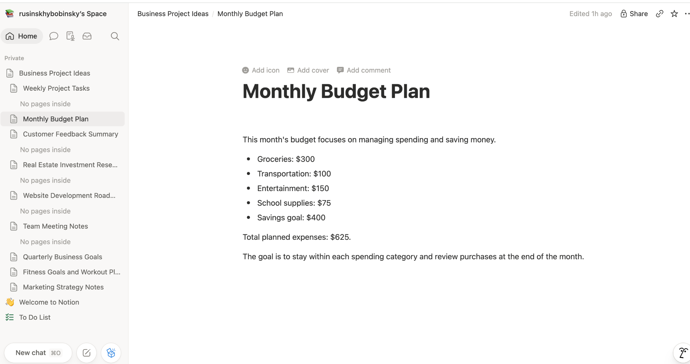
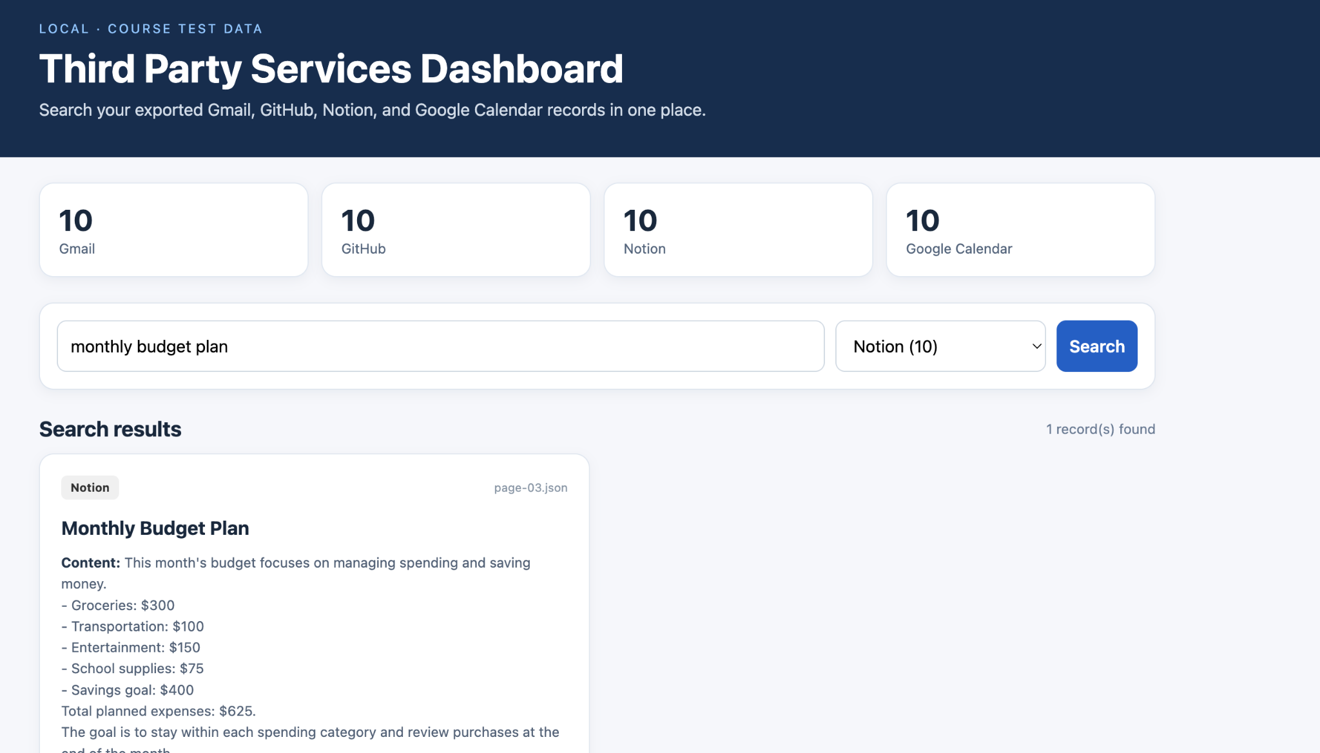
Notion — Source vs. Dashboard
Monthly Budget Plan
ORIGINAL SERVICE
LOCAL DASHBOARD
Budget amounts and text are searchable from the local Notion export.
THIRD PARTY SERVICES DASHBOARD • OCTOBER 2026
5

Slide 6
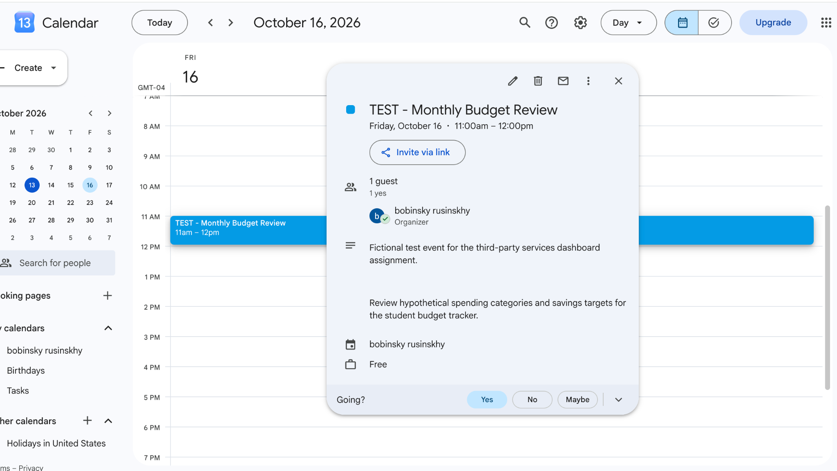
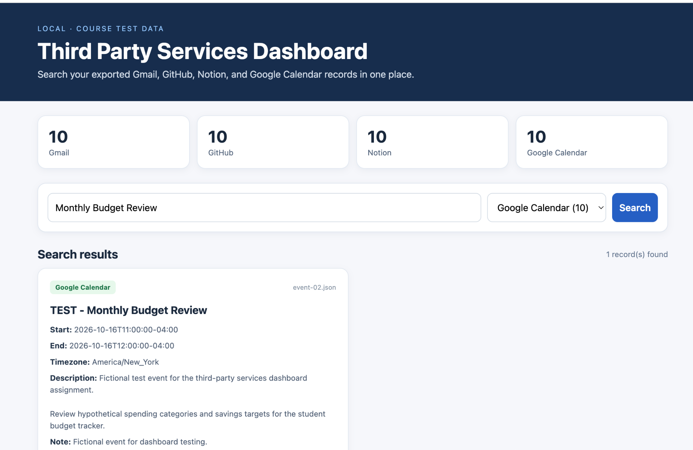
Google Calendar — Source vs. Dashboard
TEST — Monthly Budget Review
ORIGINAL SERVICE
LOCAL DASHBOARD
Event date, time, title and description match the calendar record.
THIRD PARTY SERVICES DASHBOARD • OCTOBER 2026
6

Slide 7
Cross-Service Search
One keyword retrieves matching records from several independent sources
Search: budget
11 matching
records
Results are labeled with their source service.
THIRD PARTY SERVICES DASHBOARD • OCTOBER 2026
7

Slide 8
Data Storage and Validation
A consistent, readable JSON structure across four service folders
third-party-services-project/
VALIDATION RESULT
dataExports/
github/ 10 JSON files
gmail/ 10 JSON files
notion/ 10 JSON files
google-calendar/ 10 JSON files
server.py
validate_exports.py
localStorageFormats.md
README.md
PASS
40 JSON records passed structural checks.
Scope: verifies required fields and readability. It does not certify a complete raw API export.
THIRD PARTY SERVICES DASHBOARD • OCTOBER 2026
8

Slide 9
Implementation and Verification
Completed project components and the scope of current verification
PROJECT DELIVERABLES
VERIFICATION NOTES
✓ 40 original JSON records; 20 later metadata records
✓ Local searchable Python dashboard
✓ Service-specific and cross-service search
✓ JSON structural validator passes
✓ Four-service MCP configuration included
• Public GitHub repository includes project files
• GitHub MCP successfully fetched README
• Notion MCP connection listed tools
• Google MCP endpoints require separate authorization
• Demo is an edited walkthrough, not live capture
THIRD PARTY SERVICES DASHBOARD • OCTOBER 2026
9

